Slide 1
Introduction to machine learning

Slide 2
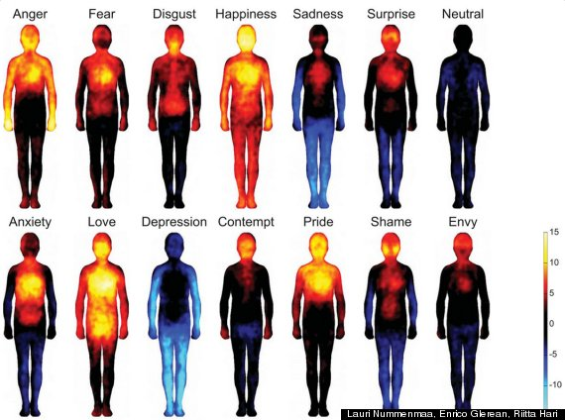
Human Body Temperature Distribution According to Their Emotional State
Source: http://www.huffingtonpost.co.uk/2014/01/06/body-temperature-changes-emotions-love-depression_n_4549145.html

Slide 3
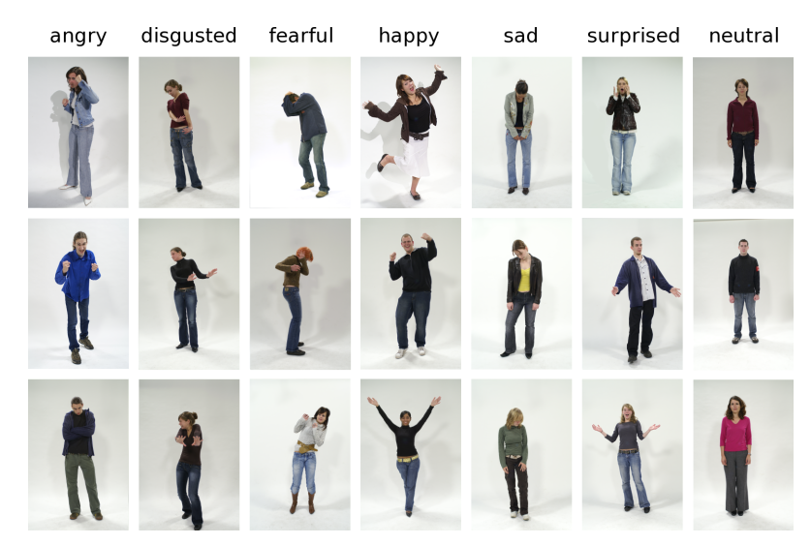
Human emotions and postures
Source: “Recognizing Emotions Expressed by Body Pose: a Biologically Inspired Neural Model” by Schindler et al, Neural Networks, 2008, https://goo.gl/kJ3BNg

Slide 4
Threat Perception in Real Time Security Systems
Can we recognize emotions
from posture and thermographs?
of an individual in a group or crowd?
Can we link recognized emotions to predict possible threat from an individual in a crowd monitored using thermographs and gait analysis from video cameras?

Slide 5
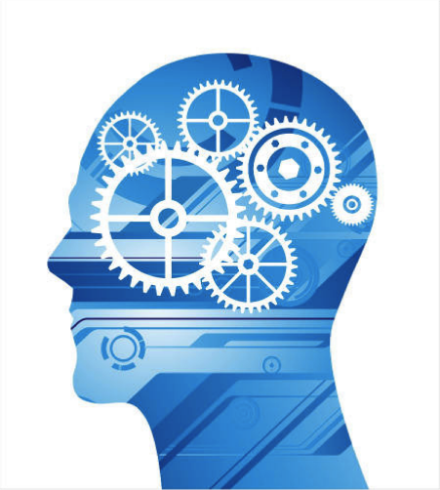
What resolution?
Video camera
Correlate and Classify Acquired Images Into Predefined Set of Emotions Based on Temperature Distribution And Postures
Storage devices
Infra red camera
Data transfer speeds
Data?
Good accuracy
Algorithm
Programmable chips
Identify Emotions from Body Temperature Distributions
and Posture of humans
Less uncertainty
Work for group
of humans?
Programmable?
Execution time?
Is it scalable?

Slide 6
Threat Perception in Real Time Security Systems
Desired features of an algorithm
Programmable/ Automate
Realistic computation time
Accurate and Precise, independent of data accuracy/precision
Considerations for the data
Required accuracy and precision in thermograph and video resolution, magnification
How can we automate/program this task?
Possibly embed this into camera chip and link it to the security system?
See: Multi-sensor Surveillance Systems: The Fusion Perspective, edited by Gian Luca Foresti, Carlo S. Regazzoni, Pramod K. Varshney, Google books URL: https://goo.gl/m10vAG

Slide 7
Outline
What is Machine Learning?
What machine learning can do?
Machine learning models/algorithms
Design of Machine Learning Study
Goals and Objectives of This Module
Summary and Comments

Slide 8
What is “Machine Learning”?
Algorithms and techniques used for data analytics
Studies how to automatically learn to make accurate predictions based on past observations
Machine learning is programming computers to optimize a performance criterion by tuning set of parameters . These tuned programs then perform same task on unseen data.
New
Examples
Machine Learning
Algorithm
Training
Examples
Classification
Rule
Predicted Class

Slide 9
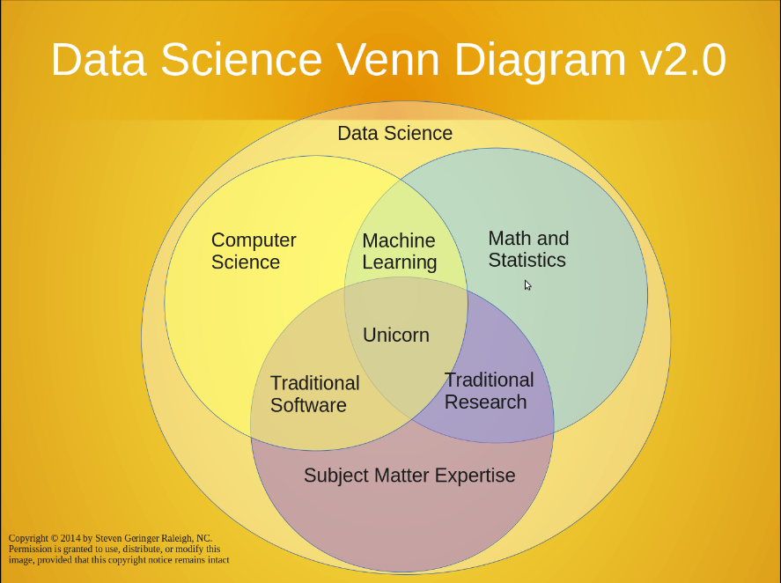


Slide 10
Machine Learning is used when…
Human expertise does not exist
Navigating on Mars
Humans are unable to explain their expertise
speech recognition
mine detection
Solution changes or evolves in time
routing on a computer network
Solution needs to be adapted to particular cases
user biometrics, virtual agent based solutions)

Slide 11
Applications
Retail: Market basket analysis, Customer relationship management (CRM)
Finance: Credit scoring, fraud detection
Manufacturing: Optimization, troubleshooting
Medicine: Medical diagnosis, Prognosis
Telecommunications: Quality of service optimization
Bioinformatics: Motifs, alignment
Web mining: Search engines
And many more….

Slide 12
Algorithms
The success of machine learning system also depends on the algorithms.
The algorithms control the search to find and build the knowledge structures.
The learning algorithms should extract useful information from training examples.
Machine Learning Algorithms
Supervised Learning
Unsupervised Learning
Reinforcement Learning

Slide 13

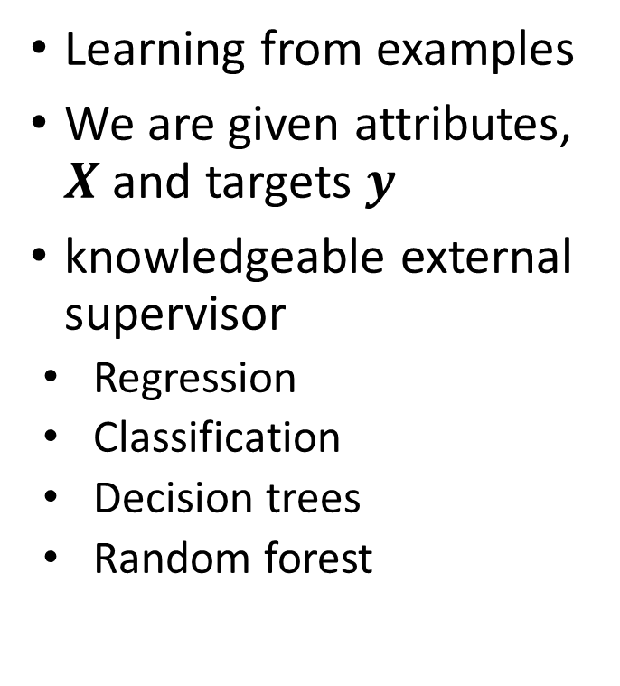



Supervised Learning
Learning from examples
We are given attributes, $X$ and targets $y$
knowledgeable external supervisor
Regression
Classification
Decision trees
Random forest
Training Data
Feature Extraction
$$y$$
$$X$$
$$\hat{y}$$
ML Model
$$\hat{w}$$
ML Algorithm
Performance metric

Slide 14
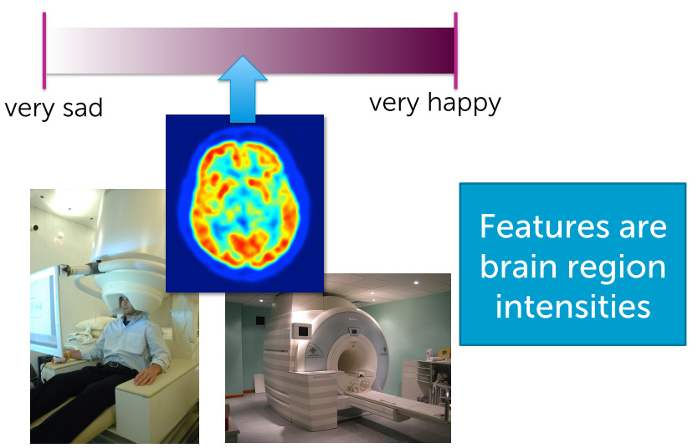
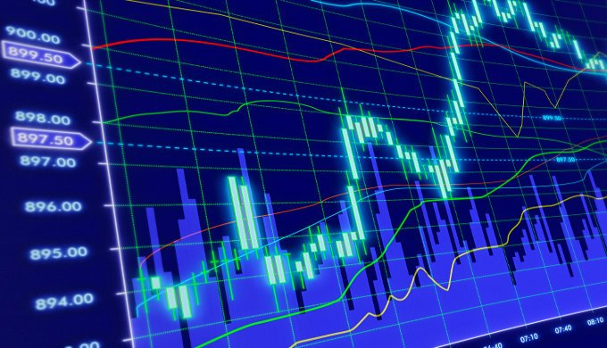
Regression: Examples
Reading your mind
Predicting stock prices
Happiness state is related to brain region intensities
Depends on
Recent stock prices
News Events
Related commodities

Slide 15
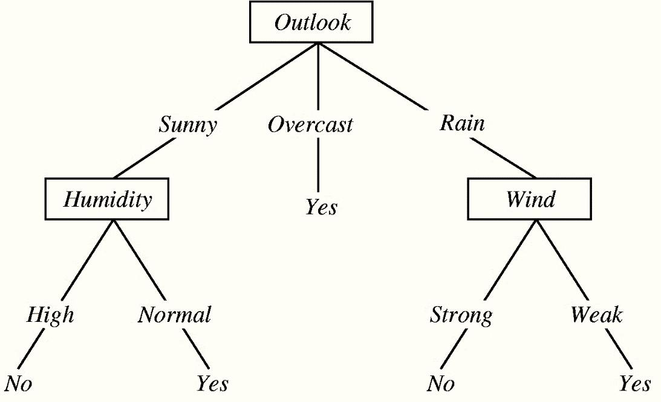
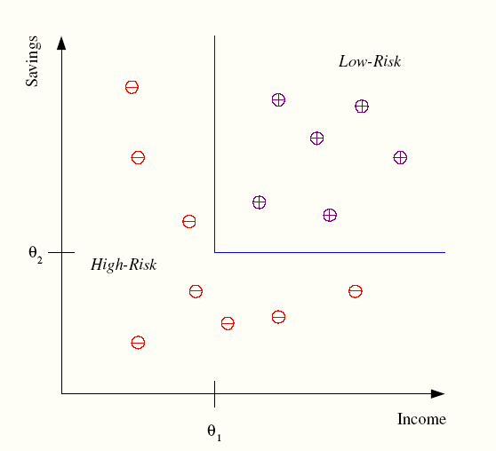
Classification: Examples
Credit scoring
Outlook of the day and Weather derivatives
Differentiating between low-risk and high-risk customers from their income and savings

Slide 16
Classification: Applications
Also known as Pattern recognition
Face recognition: Pose, lighting, occlusion (glasses, beard), make-up, hair style
Character recognition: Different handwriting styles.
Speech recognition: Temporal dependency.
Use of a dictionary or the syntax of the language.
Sensor fusion: Combine multiple modalities; eg, visual (lip image) and acoustic for speech
Medical diagnosis: From symptoms to illnesses
Web Advertising: Predict if a user clicks on an ad on the Internet.

Slide 17

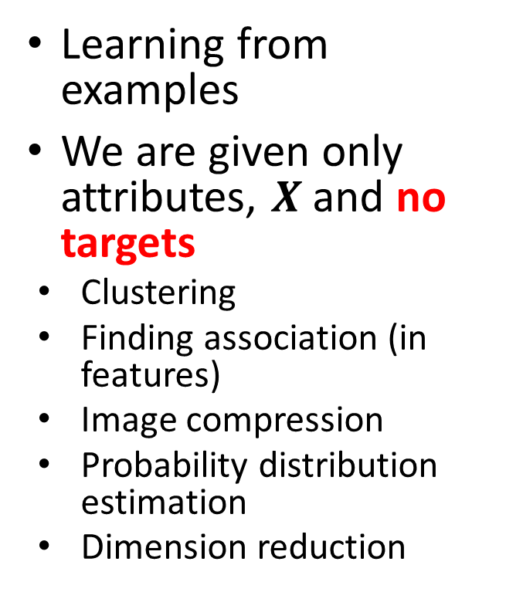

Unsupervised Learning
Learning from examples
We are given only attributes, $X$ and no targets
Clustering
Finding association (in features)
Image compression
Probability distribution estimation
Dimension reduction
Training Data
Feature Extraction
$$X$$
Intelligence:
Segmentation,
Pattern, Cluster
ML Model
$$\hat{w}$$
ML Algorithm
Performance metric

Slide 18
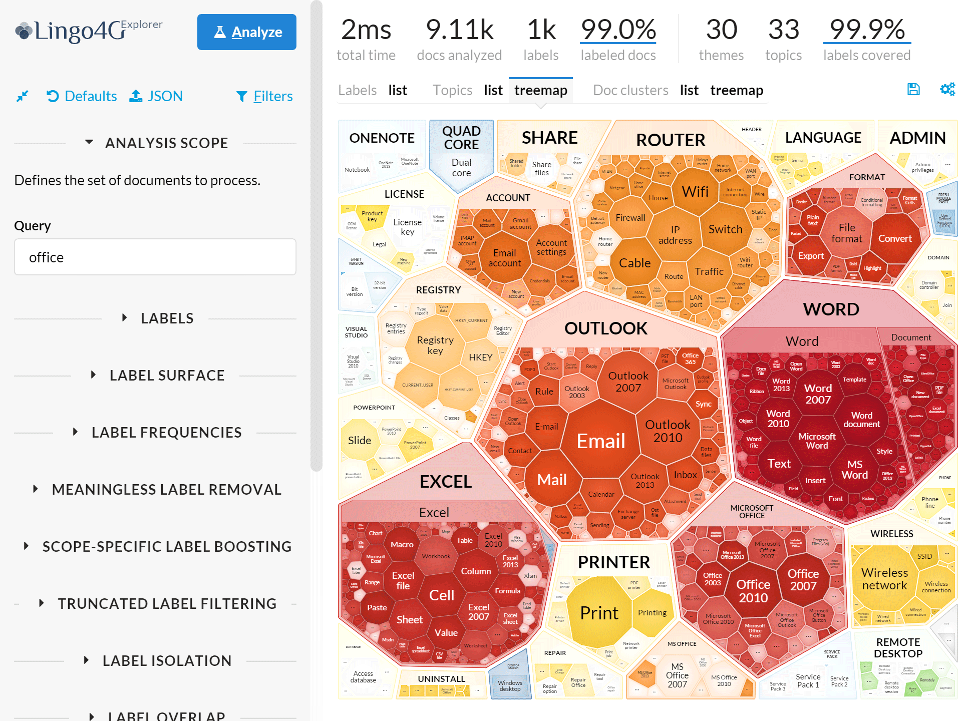
Document Clustering and Text Mining
Lingo4G: Large-scale text clustering
Topic discovery
Document clustering
Document retrieval
No external taxonomies
Scalable
Image source: https://get.carrotsearch.com/lingo4g/latest/doc/#explorer-results-view

Slide 19
Learning Associations
Basket analysis:
P (Y | X ) probability that somebody who buys X also buys Y where X and Y are products/services.
Example: P ( chips | beer ) = 0.7
Market-Basket transactions

Slide 20
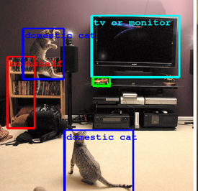
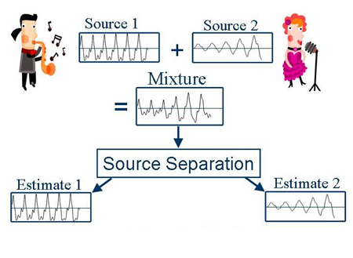
Object recognition
Image Object recognition
Blind source separation
Recognize objects in the image
Recognize source/s in a mixed music signal

Slide 21
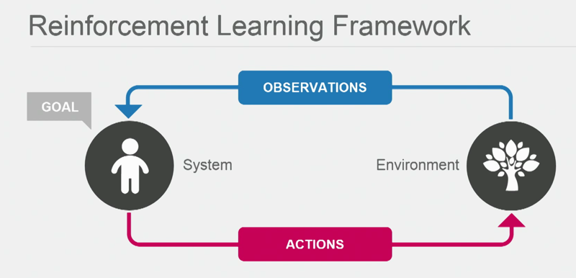
Reinforcement learning
Mimics intelligent system
Observers interaction of environment and system actions
Optimize goal/rewards
Continuous, self-learning
It is not a method but a process as a whole to build knowledge
Corrective action even if system sees a new situation
Image Source: http://www.33rdsquare.com/2015/05/demis-hassabis-theory-of-everything.html
Applications
Decision making
Robot, Chess machine
Optimal control theory
Stochastic approximations

Slide 22
Machine Learning and Traditional Statistics
Machine Learning
Traditional Statistics
Emphasize predictions, usually no super-population model specified
Evaluates results via prediction performance
Concern for overfitting but not model complexity per se
Emphasizes super-population inference
Focuses on a-priori hypotheses
Simpler models preferred over complex ones (parsimony), even if the more complex models perform slightly better

Slide 23
Continued… Machine Learning and Traditional Statistics
Machine Learning
Traditional Statistics
Emphasis on performance
Generalizability is obtained through performance on novel datasets
Concern over performance and robustness
Emphasis on parameter interpretability
Statistical modelling or sampling assumptions connects data to a population of interest
Concern over assumptions and robustness

Slide 24
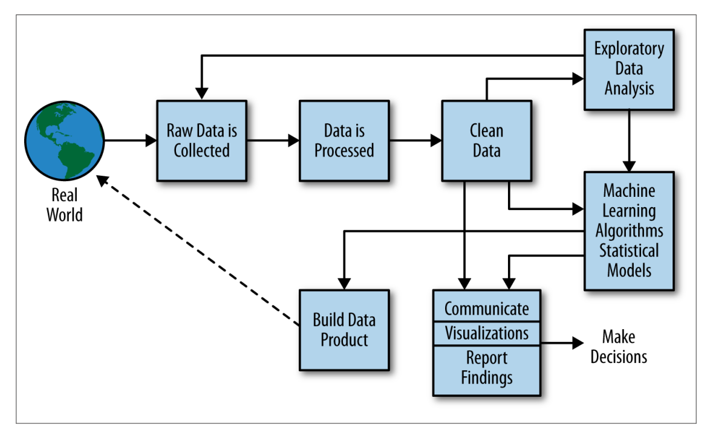
Machine learning design study: Data science process
Source: “Doing data science” by Schutt, R and O’Neil, C

Slide 25
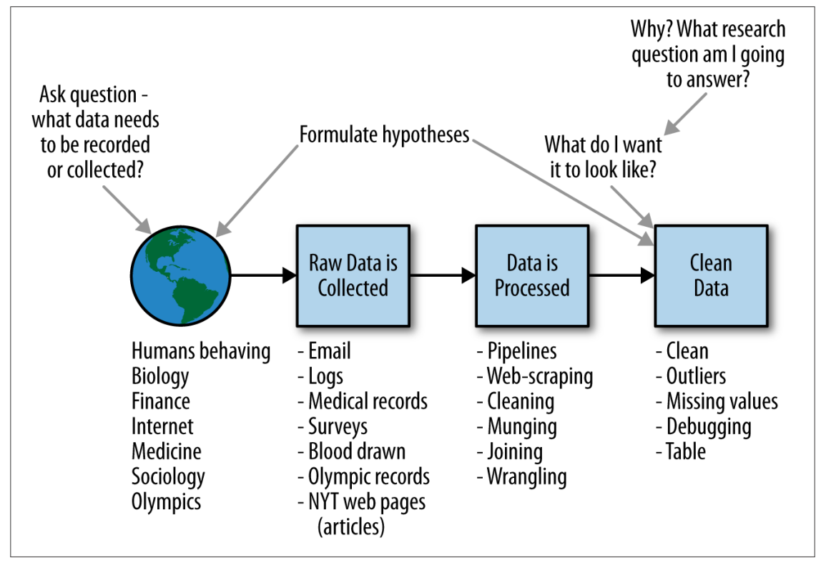
Machine learning design study: Data scientist role
Source: “Doing data science” by Schutt, R and O’Neil, C

Slide 26
Course content: Machine learning Algorithms
Supervised Learning
Unsupervised Learning
Regression
Ordinary Least Squares
Logistic
Decision Trees
Random Forests
Classification
K-Nearest Neighbour (KNN)
Logistic Regression
Trees
Support Vector Machine (SVM)
Naïve-Bayes
Clustering & Dimensionality Reduction
K-means
SVD
PCA
Association Analysis
Apriori
Market basket analysis
Hidden Markov Model
Continuous
Categorical

Slide 27
Course philosophy: Always use case study and ..
Core Concept
Visual
Algorithm
Practical
Implement
Advanced Concepts

Slide 28
Resources: Datasets
UCI Repository: http://www.ics.uci.edu/~mlearn/MLRepository.html
UCI KDD Archive: http://kdd.ics.uci.edu/summary.data.application.html
Statlib: http://lib.stat.cmu.edu/
Delve: http://www.cs.utoronto.ca/~delve/

Slide 29
Resources: Journals
Journal of Machine Learning Research www.jmlr.org
Machine Learning
IEEE Transactions on Neural Networks
IEEE Transactions on Pattern Analysis and Machine Intelligence
Annals of Statistics
Journal of the American Statistical Association
...

Slide 30
Resources: Conferences
International Conference on Machine Learning (ICML)
European Conference on Machine Learning (ECML)
Neural Information Processing Systems (NIPS)
Computational Learning
International Joint Conference on Artificial Intelligence (IJCAI)
ACM SIGKDD Conference on Knowledge Discovery and Data Mining (KDD)
IEEE Int. Conf. on Data Mining (ICDM)

Slide 31
Summary
We had a broad overview of
machine learning philosophy
Different algorithms
Application fields of machine learning
Examples
Provided links to datasets, journals and conferences related to the machine learning.
We also introduced
Course content
recommended approach to master machine learning techniques

Slide 32
Thank you!

